Slide 1
Randomized Algorithms For Concurrency Testing
Madan Musuvathi
Microsoft Research

Slide 2
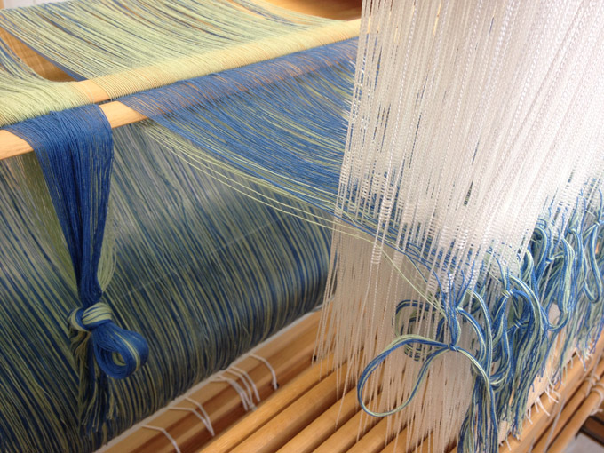
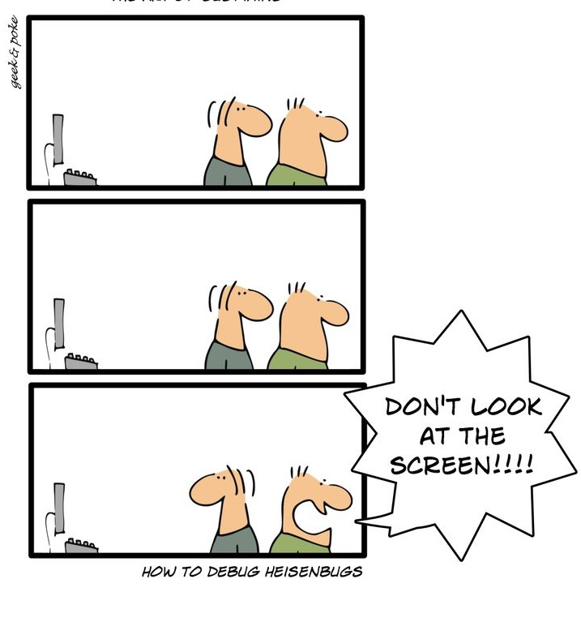
Concurrency is HARD

Slide 3
Clouds services are complex
External Services
Storage
Distributed
Asynchronous
Fault-prone
Frontend
Backend
Concurrency Bugs
Fault-Tolerance Bugs
Unavailability
Data loss
Data inconsistency
Performance problems
…

Slide 4
Amazon EC2 and Amazon RDS Service Disruption [2011]
configuration change
specific set of setps
concurrency

Slide 5
Verification vs Testing
=
proof
search
=
bug
search

Slide 6
Random is effective! [Thomson et al. PPoPP ’14, TOPC ‘16]
PCT
RAND
CHESS
DFS

Slide 7
Verification vs Testing
=
proof
search
=
bug
search
Can we design disciplined testing techniques ?
Can such techniques beat random testing & verification in finding bugs?

Slide 8
PCT: Probabilistic Concurrency Testing [ASPLOS ‘10]
A randomized scheduler for finding concurrency bugs
Probabilistic guarantees
Every run finds every bug with nontrivial probability
Repeated runs increase the chance of finding a bug
Scalable
In the no. of threads and program size

Slide 9
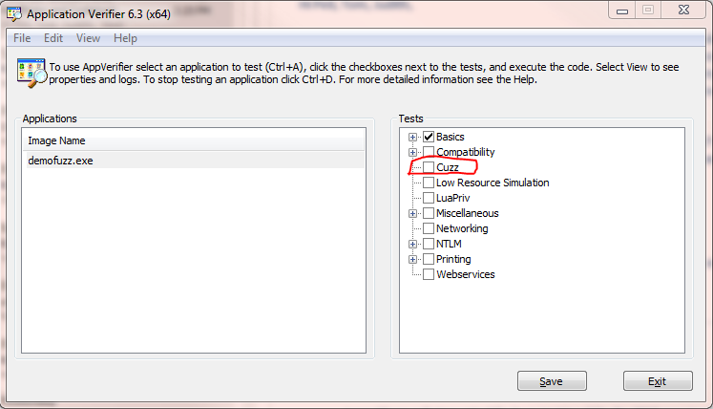
PCT status
Literally a “push button”
Ships as part of Application Verifier and Driver Verifier
Finds bugs in well-tested software in its first run
Testing with PCT is required for third-party driver verification
Torch – extension of PCT for distributed systems
Work in progress
Is finding ~5 critical bugs every week

Slide 10
Design strategy
Hypothesis: bugs have simple root causes
One reason why random testing is effective
Classify bugs into classes of increasing complexity
Design algorithms to efficiently cover bug classes

Slide 11
Classifying concurrency bugs
Root cause of a bug
= set of ordering constraints sufficient to find the bug
$$a→b,$$
$$c→d,$$
$$e →f$$
Bug depth = size of the minimum such set

Slide 12
A Bug of Depth 1
Bug Depth = no. of ordering constraints sufficient to find the bug
Possible schedules
A B C D E F G H I J ✓
A B F G H C D E I J ✗
A B F G C D E H I J ✓
A B F G C H D E I J ✓
A B F G H I J C D E ✗
…
Parent
Child
A: …
B: fork (child);
C: p = malloc();
D: …
E: …
F: ….
G: do_init();
H: p->f ++;
I: …
J: …

Slide 13
A Bug of Depth 2
Bug Depth = no. of ordering constraints sufficient to find the bug
Possible schedules
A B C D E F G H I J ✓
A B C D E H I J F G ✗
A B C H I D E G J ✓
A B C D H E F I J G ✓
A B C H D E I J F G ✗
…
Parent
Child
A: …
B: p = malloc();
C: fork (child);
D: ….
E: if (p != NULL)
F: p->f ++;
G:
H: …
I: p = NULL;
J : ….

Slide 14
Another Bug of Depth 2
Bug Depth = no. of ordering constraints sufficient to find the bug
Parent
Child
A: …
B: Lock (A);
C: …
D: Lock (B);
E: …
F: …
G: Lock (B);
H: …
I: Lock (A);
J: …

Slide 15
Formal definition of bug depth
A system is defined by its set of executions $S$
Each execution is a sequence of labelled events
A concurrency bug $B$ is some strict subset of $S$
A B C D E F G H I J
A B F G H C D E I J …
$$B$$
$$S$$

Slide 16
Formal definition of bug depth
An ordering constraint $c$ is a pair of events
$$c=(a→b)$$
A schedule s satisfies $\left(a→b\right)$if $a$ occurs before $b$ in s
$S\left(c_{1},…, c_{d}\right)=$set of schedules that satisfy $c_{1},…, c_{d}$
A B C D E F G H I J
A B F G H C D E I J
…
$$B$$
$$S$$
$$S((H→C))$$
A B F G H C D E I J ✗
A B F G H I J C D E ✗

Slide 17
Formal definition of bug depth
A bug $B$ is of depth $d$ if there exists $c_{1}…c_{d}$ such that
$S\left(c_{1},…, c_{d}\right)⊆B$
and $d$ is the smallest such for $B$
A B C D E F G H I J
A B F G H C D E I J
…
$$B$$
$$S$$
$$S((H→C))$$
A B F G H C D E I J ✗
A B F G H I J C D E ✗

Slide 18
Finding all bugs of depth d
A set of schedules $T$ covers all bugs of depth $d$ if
$$∀ c_{1},…,c_{d} :S\left(c_{1}, …, c_{d}\right)∩T≠φ$$
Coverage problem: find the smallest such $T$
$$S((A→B))$$
$$S((A→C))$$
$$S((H→C))$$
$$T$$
$$S((C→B))$$
$$S((A→D))$$

Slide 19
Let’s study when $d=1$
Need to cover all of:
a
b
g
g
b
b
h
h
b
b
g
c
g
g
c
c
h
c
h
h
c
e
g
g
e
e
i
e
h
h
e
f
e
i
i
e

Slide 20
Let’s study when $d=1$
Need to cover all of:
a
b
g
g
b
b
h
h
b
b
g
c
g
g
c
c
h
c
h
h
c
e
g
g
e
e
i
e
h
h
e
f
e
i
i
e
Two interleavings
are sufficient!
a
b
c
e
g
h
i
f
a
g
h
b
c
i
e
f

Slide 21
Dimension Theory
Any partial-order G can be expressed as an intersection of a set of total orders
This set is called a realizer of G
For any unordered pair $\left(a,b\right)$ a realizer contains two total orders that cover both $a→b, b→a$
Dimension of G, $Dim\left(G\right)$is the size of the smallest realizer of G [Dushnik & Miller ‘41]
a
a
b
c
d
e
b
d
=
a
d
b
e
c
c
e

Slide 22
Encoding a partial-order in d-dimensions
c
a
=
e
b
d
b
c
e
d
a
a
b
c
d
e
$$∩$$
a
d
b
e
c

Slide 23
Solving the coverage problem for $d=2$
Assume $S$, the set of all executions of a program
is the set of all linearizations of some partial order $G$
Find a realizer $T$ of size $Dim(G)$
$T$ finds all bugs of depth 2
Two problems:
The assumption above does not hold in practice
Finding the $Dim(G)$ is NP-hard [Yannakakis ‘82]

Slide 24
Width of a Partial-Order
The minimum number of total orders needed to cover G
Width corresponds to the number of “threads” in G
$∀G :\dim\left(G\right)≤width\left(G\right)$
$∃G_{n}:\dim\left(G_{n}\right)=width\left(G_{n}\right)=n$
a
a
b
d
b
d
is covered by
c
e
c
e

Slide 25
Let’s study when $d=1$
Need to cover all of:
a
b
g
g
b
b
h
h
b
b
g
c
g
g
c
c
h
c
h
h
c
e
g
g
e
e
i
e
h
h
e
f
e
i
i
e
A realizer of size
width(G) = 2
a
b
c
e
g
h
i
f
a
g
h
b
c
i
e
f

Slide 26
Let’s study when $d=1$
a
b
g
g
b
b
h
h
b
b
g
c
g
g
c
c
h
c
h
h
c
e
g
g
e
e
i
e
h
h
e
f
e
i
i
e
a
b
c
e
g
h
i
f
a
g
h
b
c
i
e
f

Slide 27
Solving the coverage problem for $d=2$
Assume the program has $n$ threads
For each thread $t$ generate an execution with $t$ as the lowest priority
$t$ runs only when all other threads are blocked
The $n$ executions above find all bugs of depth
PCT algorithm uniformly samples from this set

Slide 28
PCT algorithm for $d=2$
Each thread gets a random priority
Run the highest-priority enabled thread at each step
A “parallel” PCT [PLDI ’12] only blocks the lowest priority thread
Note: the algorithm is online
does not require the partial-order to be presented in its entirely

Slide 29
Extending dimension theory for $d>2$
A $d$-realizer of $G$ covers every set of $d$ ordering constraints $c_{1}…c_{d}$
Proof: every partial order $G$ has a $d$-realizer of size
$$\frac{1}{n⋅k^{d−1}}$$
where $n=width\left(G\right)$ and $k=|G|$
PCT is a randomized algorithm for uniformly sampling such a realizer

Slide 30
PCT Algorithm
Inputs: n: estimated bound on the number of threads
k: estimated bound on the number of steps
d: target bug depth
// 1. assign random priorities >= d to threads
for t in [1…n] do priority[t] = rand() + d;
// 2. chose d-1 lowering points at random
for i in [1...d) do lowering[i] = rand() % k;
steps = 0;
while (some thread enabled) {
// 3. Honor thread priorities
Let t be the highest-priority enabled thread;
schedule t for one step;
steps ++;
// 4. At the ith lowering point, set the priority to i
if steps == lowering[i] for some i
priority[t] = i;
}

Slide 31
PCT guarantee
PCT finds every bug of depth $d$ in every run with probability at least $\frac{1}{n⋅k^{d−1}}$
where $n$ is the max. no. of threads
and $k$ is the max. no. of instructions in an execution

Slide 32
Comparison with Worst-Case Bound
Program | Empirical | Bound
Splash – Barnes | 0.5 | 0.5
Splash – LU | 0.5 | 0.5
Splash- Barnes | 0.49 | 0.5
Pbzip | 0.701 | 0.0001
Work Steal Queue | 0.002 | 0.0003
Dryad | 0.164 | 2x10⁻⁵

Slide 33
Open challenges
Dimension theory for d constraints is largely unstudied
No known lower-bound for the size of a d-realizer
Scalability of PCT is limited by its dependence on${ k}^{d−1}$
Need to incorporate fairness
Consistently slowing down the low-priority thread can cause starvation + application timeouts

Slide 34
Hitting Families [Dmitry et al. CAV 2016]
Studied covering constraints of the form
$$a→b→c→d$$
(as opposed to $a→b, c→d, e→f$)
In trees
$\dim\left(Tree\right)=2≪width(Tree)$
a
b
c
d
e
f
g
h
i

Slide 35
Hitting families
Key results:
Antichains with k elements have hitting families of size $O(\exp\left(d\right)⋅\log{k)}$ (non constructive proof)
Trees with height h
4h schedules cover $a→b→c$ constraints
$O(\exp\left(d\right)⋅h^{d−1})$ schedules cover $a_{1}→a_{2}→…{→a}_{d}$
Need constructive online versions of these algorithms

Slide 36
Generalization to Fault Injection Testing
Recent work by Filip Niksic & Rupak Majumdar
Efficiently inject faults to cover all interesting network partitions

Slide 37
Conclusion

